Slide 1

Programmeren Summerschool
Hoorcollege C
06 juli 2016
tinyurl.com/minprog2016
Jaap van Bergeijk
j.h.vanbergeijk@uva.nl

Slide 2
Programma vandaag
Variabelen
Types
Prints
Loops, conditions
Style
IDE

Slide 3
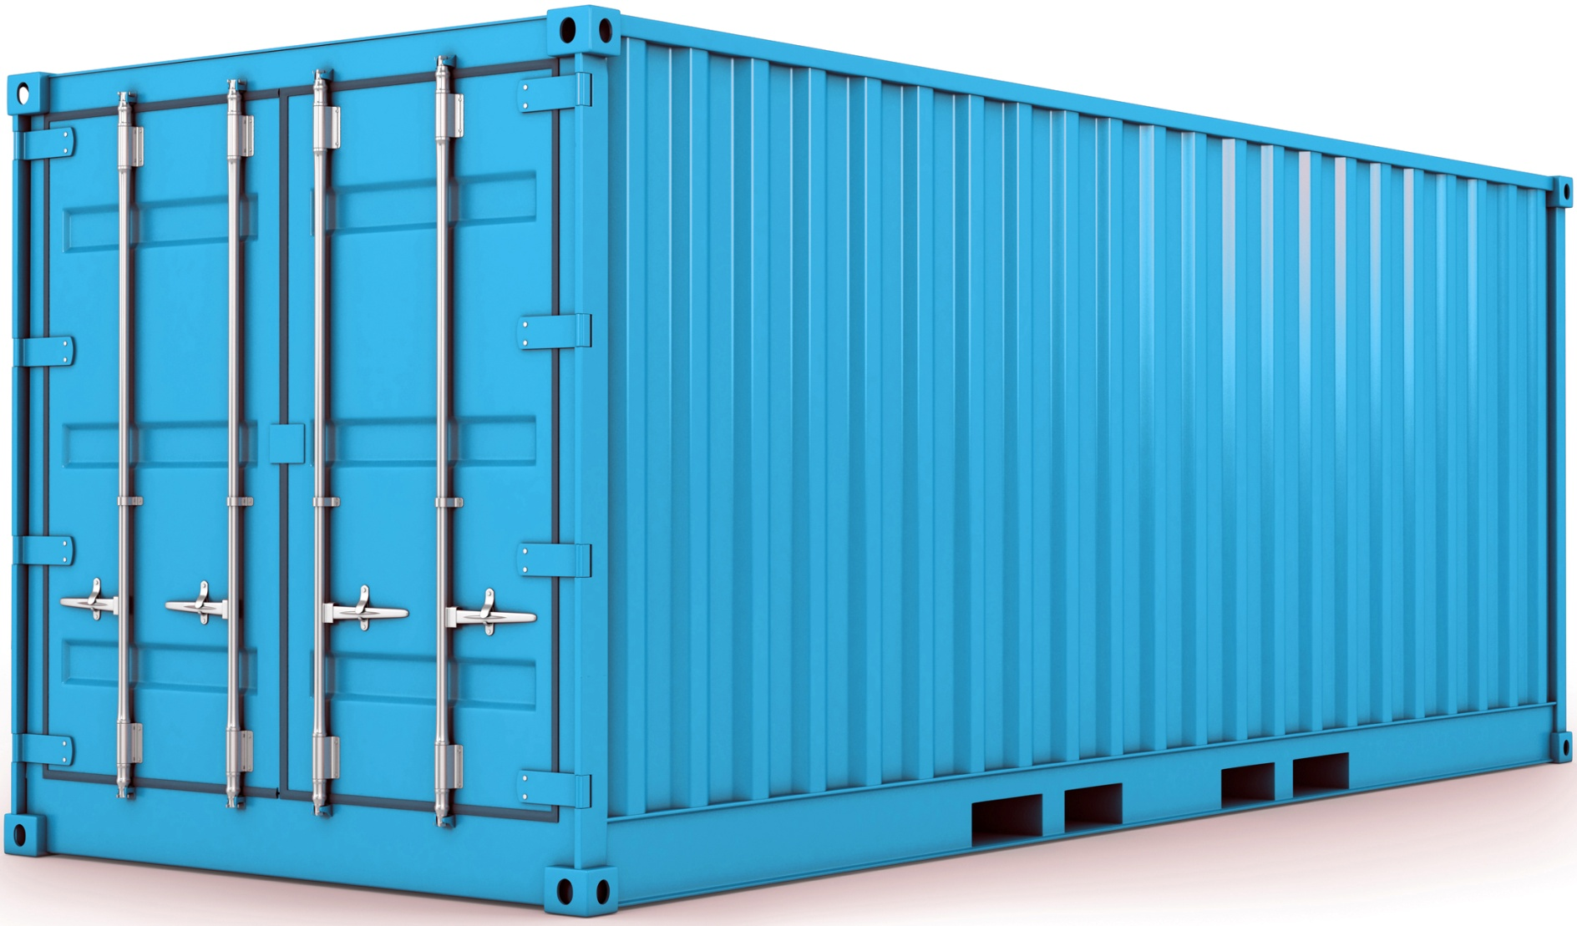
Variabelen

Slide 4
Variabelen
name

Slide 5
Types
int, long, double, float
char, String, char*

Slide 6
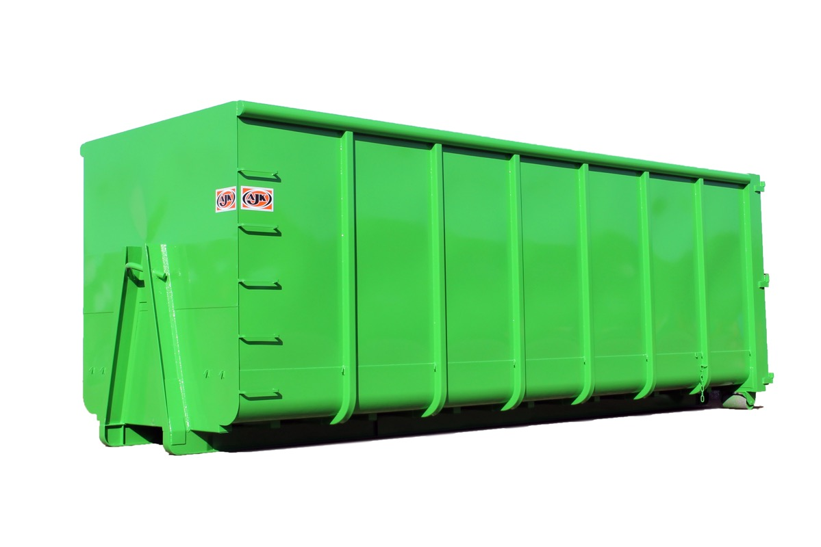

Types
int →
number
name
← String

Slide 7

Key concepts (if, else if, else)
if (some_value < 7)
{
some_value += 3;
}
if (some_value == 7)
{
some_value++;
}
if (some_value > 7)
{
some_value = 0;
}

Slide 8

Key concepts (if, else if, else)
if (some_value < 7)
{
some_value += 3;
}
else if (some_value == 7)
{
some_value++;
}
else
{
some_value = 0;
}

Slide 9
Key concepts (loops)
for (*initialisatie*; *conditie*; *update*)
{
//code
}

Slide 10
Key concepts (loops)
int i = 0, heigt = 2;
for ( ; i < height; i++)
{
i++;
printf(“%d”, i);
}
while (i < height)
{
printf(“%i”, i);
}
do
{
printf(“%d”, i);
i++;
}
while (i < height)

Slide 11
Key concepts (loops)
while (*conditie*)
{
//code
}

Slide 12
Key concepts (loops)
int i = 0, heigt = 2;
for ( ; i < height; i++)
{
i++;
printf(“%d”, i);
}
while (i < height)
{
printf(“%i”, i);
}
do
{
printf(“%d”, i);
i++;
}
while (i < height)

Slide 13
Key concepts (loops)
do
{
//code
}
while (*conditie*)

Slide 14
Key concepts (loops)
int i = 0, heigt = 2;
for ( ; i < height; i++)
{
i++;
printf(“%d”, i);
}
while (i < height)
{
printf(“%i”, i);
}
do
{
printf(“%d”, i);
i++;
}
while (i < height)

Slide 15
Key concepts (style)
/*******************************************************
* <Naam van de file>
*
* <Naam van het vak>
* <Jouw naam>
* <Jouw studentnummer>
*
* <Wat doet je programma>
*
* <Welke functionaliteiten c.q. leerdoelen \
* zijn er met het programma gemoeid>
*******************************************************/
ZIE GITHUB StyleGuide !!

